Slide 1
Cloud Computing
Muheet Ahmed Butt

Slide 2
Definition
Generally speaking, cloud computing can be thought of as anything that involves delivering hosted services over the Internet.
Cloud computing is computing in which large groups of remote servers are networked to allow centralized data storage and online access to computer services or resources. Clouds can be classified as public, private or hybrid
According to NIST Cloud computing is a model for enabling ubiquitous, convenient, on-demand network access to a shared pool of configurable computing resources (e.g., networks, servers, storage, applications, and services) that can be rapidly provisioned and released with minimal management effort or service

Slide 3
from CAPEX to OPEX

Slide 4
Sharing
Cloud computing relies on sharing of resources to achieve coherence and economies of scale, similar to a utility (like the electricity grid) over a network.
At the foundation of cloud computing is the broader concept of converged infrastructure and shared services.
The present availability of high-capacity networks, low-cost computers and storage devices as well as the widespread adoption of hardware virtualization, service-oriented architecture, and autonomic and utility computing have led to a growth in cloud computing.
Cloud vendors are experiencing growth rates of 50% per annum
Cloud computing is the result of evolution and adoption of existing technologies and paradigms.
The goal of cloud computing is to allow users to take beneﬁt from all of these technologies, without the need for deep knowledge about or expertise with each one of them.
The cloud aims to cut costs, and helps the users focus on their core business instead of being impeded by IT obstacles

Slide 5
History
The underlying concept of cloud computing dates to the 1950s, when large-scale mainframe computers this nomenclature was mostly associated with large vendors such as IBM and DEC.
In the 1990s, telecommunications companies, who previously offered primarily dedicated point-to-point data circuits, began offering virtual private network (VPN) services with comparable quality of service, but at a lower cost.
In early 2008, Eucalyptus became the first open-source, AWS API-compatible platform for deploying private clouds. In early 2008,
OpenNebula, enhanced in the RESERVOIR European Commission-funded project, became the first open-source software for deploying private and hybrid clouds, and for the federation of clouds.
In the same year, efforts were focused on providing quality of service guarantees (as required by real-time interactive applications) to cloud-based infrastructures, in the framework of the IRMOS European Commission-funded project, resulting in a real-time cloud environment.
By mid-2008, Gartner saw an opportunity for cloud computing "to shape the relationship among consumers of IT services,
In July 2010, Rackspace Hosting and NASA jointly launched an open-source cloud-software initiative known as OpenStack. The OpenStack project intended to help organizations offer cloud-computing services running on standard hardware. The early code came from NASA's Nebula platform as well as from Rackspace's Cloud Files platform.^{[23]}
On March 1, 2011, IBM announced the IBM SmartCloud framework to support Smarter Planet. Among the various components of the Smarter Computing foundation, cloud computing is a critical piece.
On June 7, 2012, Oracle announced the Oracle Cloud. While aspects of the Oracle Cloud are still in development, this cloud offering is posed to be the first to provide users with access to an integrated set of IT solutions, including the Applications (SaaS), Platform (PaaS), and Infrastructure (IaaS) layers.

Slide 6
Similar Developments
Cloud computing is a kind of grid computing; it has evolved by addressing the QoS (quality of service) and reliability problems.
Cloud computing provides the tools and technologies to build data/compute intensive parallel applications with much more affordable prices compared to traditional parallel computing techniques.
Grid computing — "A form of distributed and parallel computing, whereby a 'super and virtual computer' is composed of a cluster of networked, loosely coupled computers acting in concert to perform very large tasks."
Mainframe computer — Powerful computers used mainly by large organizations for critical applications, typically bulk data processing such as: census; industry and consumer statistics; police and secret intelligence services; enterprise resource planning; and financial transaction processing.
Utility computing — The "packaging of computing resources, such as computation and storage, as a metered service similar to a traditional public utility, such as electricity."
Peer-to-peer — A distributed architecture without the need for central coordination. Participants are both suppliers and consumers of resources (in contrast to the traditional client–server model).

Slide 7
Characteristics
Agility improves with users' ability to re-provision technological infrastructure resources.
Application programming interface (API) accessibility to software that enables machines to interact with cloud software in the same way that a traditional user interface
Cost reductions claimed by cloud providers. A public-cloud delivery model converts capital expenditure to operational expenditure.
Device and location independence enable users to access systems using a web browser regardless of their location or what device they use (e.g., PC, mobile phone). As infrastructure is off-site (typically provided by a third-party) and accessed via the Internet, users can connect from anywhere.
Maintenance of cloud computing applications is easier, because they do not need to be installed on each user's computer and can be accessed from different places.
Multitenancy enables sharing of resources and costs across a large pool of users thus allowing for:
centralization of infrastructure in locations with lower costs (such as real estate, electricity, etc.)
peak-load capacity increases (users need not engineer for highest possible load-levels)
utilisation and efficiency improvements for systems that are often only 10–20% utilized.
Performance is monitored, and consistent and loosely coupled architectures are constructed using web services as the system interface.
Productivity may be increased when multiple users can work on the same data simultaneously, rather than waiting for it to be saved and emailed. Time may be saved as information does not need to be re-entered when fields are matched, nor do users need to install application software upgrades to their computer.
Reliability improves with the use of multiple redundant sites, which makes well-designed cloud computing suitable for business continuity and disaster recovery.
Scalability and elasticity via dynamic ("on-demand") provisioning of resources on a fine-grained, self-service basis in near real-time[(Note, the VM startup time varies by VM type, location, OS and cloud providers), without users having to engineer for peak loads.
Security

Slide 8
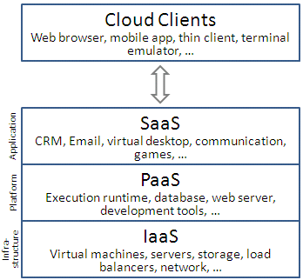
Service Models

Slide 9
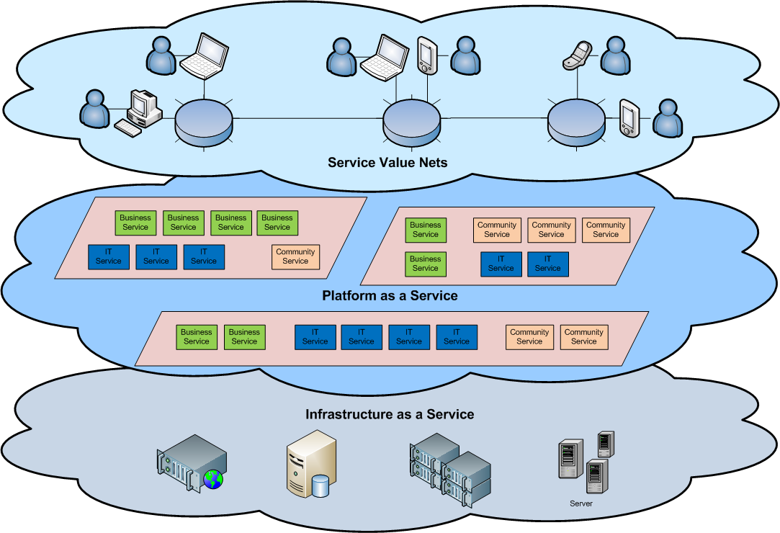
Service Models

Slide 10
Infrastructure as a service (IaaS)
In the most basic cloud-service model & according to the IETF (Internet Engineering Task Force), providers of IaaS offer computers – physical or (more often) virtual machines – and other resources.
A hypervisor, such as Xen, Oracle VirtualBox, KVM, VMware ESX/ESXi, or Hyper-V runs the virtual machines as guests.
Pools of hypervisors within the cloud operational support-system can support large numbers of virtual machines and the ability to scale services up and down according to customers' varying requirements.
IaaS clouds often offer additional resources such as a virtual-machine disk image library, raw block storage, and file or object storage, firewalls, load balancers, IP addresses, virtual local area networks (VLANs), and software bundles.
IaaS-cloud providers supply these resources on-demand from their large pools installed in data centers. For wide-area connectivity, customers can use either the Internet or carrier clouds (dedicated virtual private networks).
To deploy their applications, cloud users install operating-system images and their application software on the cloud infrastructure. In this model, the cloud user patches and maintains the operating systems and the application software.
Cloud providers typically bill IaaS services on a utility computing basis: cost reflects the amount of resources allocated and consumed

Slide 11
Platform as a service (PaaS)
In the PaaS models, cloud providers deliver a computing platform, typically including operating system, programming language execution environment, database, and web server.
Application developers can develop and run their software solutions on a cloud platform without the cost and complexity of buying and managing the underlying hardware and software layers.
With some PaaS offers like Microsoft Azure and Google App Engine, the underlying computer and storage resources scale automatically to match application demand so that the cloud user does not have to allocate resources manually. The latter has also been proposed by an architecture aiming to facilitate real-time in cloud environments.
Platform as a service (PaaS) provides a computing platform and a key chimney.
It joins with software as a service (SaaS) and infrastructure as a service (IaaS), model of cloud computing.

Slide 12
Software as a service (SaaS)
In the business model using software as a service (SaaS), users are provided access to application software and databases.
Cloud providers manage the infrastructure and platforms that run the applications. SaaS is sometimes referred to as "on-demand software" and is usually priced on a pay-per-use basis. SaaS providers generally price applications using a subscription fee.
In the SaaS model, cloud providers install and operate application software in the cloud and cloud users access the software from cloud clients.
Cloud users do not manage the cloud infrastructure and platform where the application runs. This eliminates the need to install and run the application on the cloud user's own computers, which simplifies maintenance and support.
Cloud applications are different from other applications in their scalability—which can be achieved by cloning tasks onto multiple virtual machines at run-time to meet changing work demand.
Load balancers distribute the work over the set of virtual machines. This process is transparent to the cloud user, who sees only a single access point.
To accommodate a large number of cloud users, cloud applications can be multitenant, that is, any machine serves more than one cloud user organization.

Slide 13
SaaS Contd.
The pricing model for SaaS applications is typically a monthly or yearly flat fee per user,so price is scalable and adjustable if users are added or removed at any point.
Proponents claim SaaS allows a business the potential to reduce IT operational costs by outsourcing hardware and software maintenance and support to the cloud provider.
This enables the business to reallocate IT operations costs away from hardware/software spending and personnel expenses, towards meeting other goals.
In addition, with applications hosted centrally, updates can be released without the need for users to install new software.
One drawback of SaaS is that the users' data are stored on the cloud provider's server. As a result, there could be unauthorized access to the data. For this reason, users are increasingly adopting intelligent third-party key management systems to help secure their data.

Slide 14
Unified Communications as a Service
In the UCaaS model, multi-platform communications over the network are packaged by the service provider.
The services could be in different devices, such as computers and mobile devices. Services may include IP telephony, unified messaging, video conferencing and mobile extension

Slide 15
Cloud Clients
Users access cloud computing using networked client devices, such as desktop computers, laptops, tablets and smartphones.
Some of these devices – cloud clients – rely on cloud computing for all or a majority of their applications so as to be essentially useless without it.
Examples are thin clients and the browser-based Chromebook. Many cloud applications do not require specific software on the client and instead use a web browser to interact with the cloud application.
With Ajax and HTML5 these Web user interfaces can achieve a similar, or even better, look and feel to native applications. Some cloud applications, however, support specific client software dedicated to these applications (e.g., virtual desktop clients and most email clients).
Some legacy applications (line of business applications that until now have been prevalent in thin client computing) are delivered via a screen-sharing technology.

Slide 16
Deployment Models

Slide 17
Private Clouds
Private cloud is cloud infrastructure operated solely for a single organization, whether managed internally or by a third-party, and hosted either internally or externally.
Undertaking a private cloud project requires a significant level and degree of engagement to virtualize the business environment, and requires the organization to reevaluate decisions about existing resources.
When done right, it can improve business, but every step in the project raises security issues that must be addressed to prevent serious vulnerabilities.
Self-run data centers are generally capital intensive. They have a significant physical footprint, requiring allocations of space, hardware, and environmental controls.
These assets have to be refreshed periodically, resulting in additional capital expenditures. They have attracted criticism because users "still have to buy, build, and manage them" and thus do not benefit from less hands-on management, essentially "[lacking] the economic model that makes cloud computing such an intriguing concept".

Slide 18
Public Cloud
A cloud is called a "public cloud" when the services are rendered over a network that is open for public use.
Public cloud services may be free or offered on a pay-per-usage model.
Technically there may be little or no difference between public and private cloud architecture, however, security consideration may be substantially different for services (applications, storage, and other resources) that are made available by a service provider for a public audience and when communication is effected over a non-trusted network.
Generally, public cloud service providers like Amazon AWS, Microsoft and Google own and operate the infrastructure at their data center and access is generally via the Internet.
AWS and Microsoft also offer direct connect services called "AWS Direct Connect" and "Azure ExpressRoute" respectively, such connections require customers to purchase or lease a private connection to a peering point offered by the cloud provider.

Slide 19
Hybrid Cloud
Hybrid cloud is a composition of two or more clouds (private, community or public) that remain distinct entities but are bound together, offering the benefits of multiple deployment models. Hybrid cloud can also mean the ability to connect collocation, managed and/or dedicated services with cloud resources
Gartner, Inc. defines a hybrid cloud service as a cloud computing service that is composed of some combination of private, public and community cloud services, from different service providers.^{[66]} A hybrid cloud service crosses isolation and provider boundaries so that it can’t be simply put in one category of private, public, or community cloud service. It allows one to extend either the capacity or the capability of a cloud service, by aggregation, integration or customization with another cloud service.
Varied use cases for hybrid cloud composition exist. For example, an organization may store sensitive client data in house on a private cloud application, but interconnect that application to a business intelligence application provided on a public cloud as a software service.^{[67]} This example of hybrid cloud extends the capabilities of the enterprise to deliver a specific business service through the addition of externally available public cloud services.
Another example of hybrid cloud is one where IT organizations use public cloud computing resources to meet temporary capacity needs that can not be met by the private cloud.^{[68]} This capability enables hybrid clouds to employ cloud bursting for scaling across clouds.^{[2]} Cloud bursting is an application deployment model in which an application runs in a private cloud or data center and "bursts" to a public cloud when the demand for computing capacity increases. A primary advantage of cloud bursting and a hybrid cloud model is that an organization only pays for extra compute resources when they are needed.
Cloud bursting enables data centers to create an in-house IT infrastructure that supports average workloads, and use cloud resources from public or private clouds, during spikes in processing demands.

Slide 20
Others
Community cloud: Shares infrastructure between several organizations from a specific community with common concerns (security, compliance, jurisdiction, etc.), whether managed internally or by a third-party, and either hosted internally or externally. The costs are spread over fewer users than a public cloud (but more than a private cloud), so only some of the cost savings potential of cloud computing are realized.
Distributed cloud: Cloud computing can also be provided by a distributed set of machines that are running at different locations, while still connected to a single network or hub service. Examples of this include distributed computing platforms such as BOINC and Folding@Home. An interesting attempt in such direction is Cloud@Home, aiming at implementing cloud computing provisioning model on top of voluntarily shared resources.
Intercloud : is an interconnected global "cloud of clouds“ and an extension of the Internet "network of networks" on which it is based. The focus is on direct interoperability between public cloud service providers, more so than between providers and consumers (as is the case for hybrid- and multi-cloud).
Multicloud: is the use of multiple cloud computing services in a single heterogeneous architecture to reduce reliance on single vendors, increase flexibility through choice, mitigate against disasters, etc. It differs from hybrid cloud in that it refers to multiple cloud services, rather than multiple deployment modes (public, private, legacy).

Slide 21
Pros
Cost efficient
Almost Unlimited Storage
Backup and Recovery
Automatic Software Integration
Easy Access to Information
Quick Development

Slide 22
Corns
Technical Issues
Security in the Cloud
Prone to Attack

Slide 23
Benefits of Cloud Computing
Cloud computing allows you to focus more on your business and not on managing data centers.
You can develop new applications faster.
Leveraging your cloud provider’s API can help you automate many of your operational tasks.
Cloud computing is scalable.
Financially, cloud computing makes a lot of sense.
Cloud computing allows you to expand your global presence.

